Slide 1
Welcome to Kindergarten

Slide 2
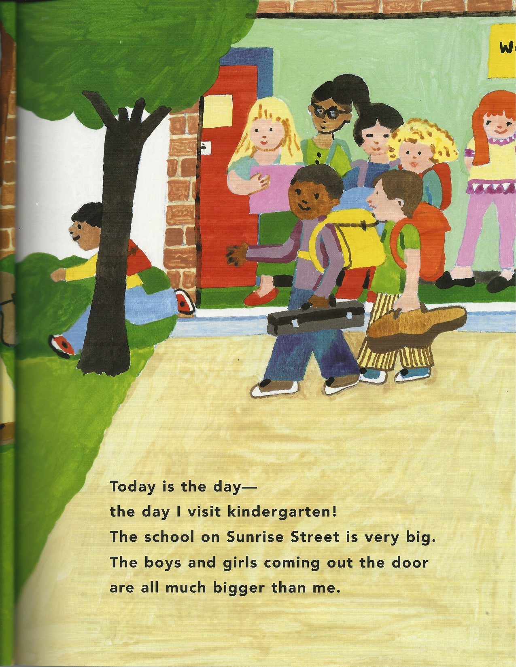

Slide 3
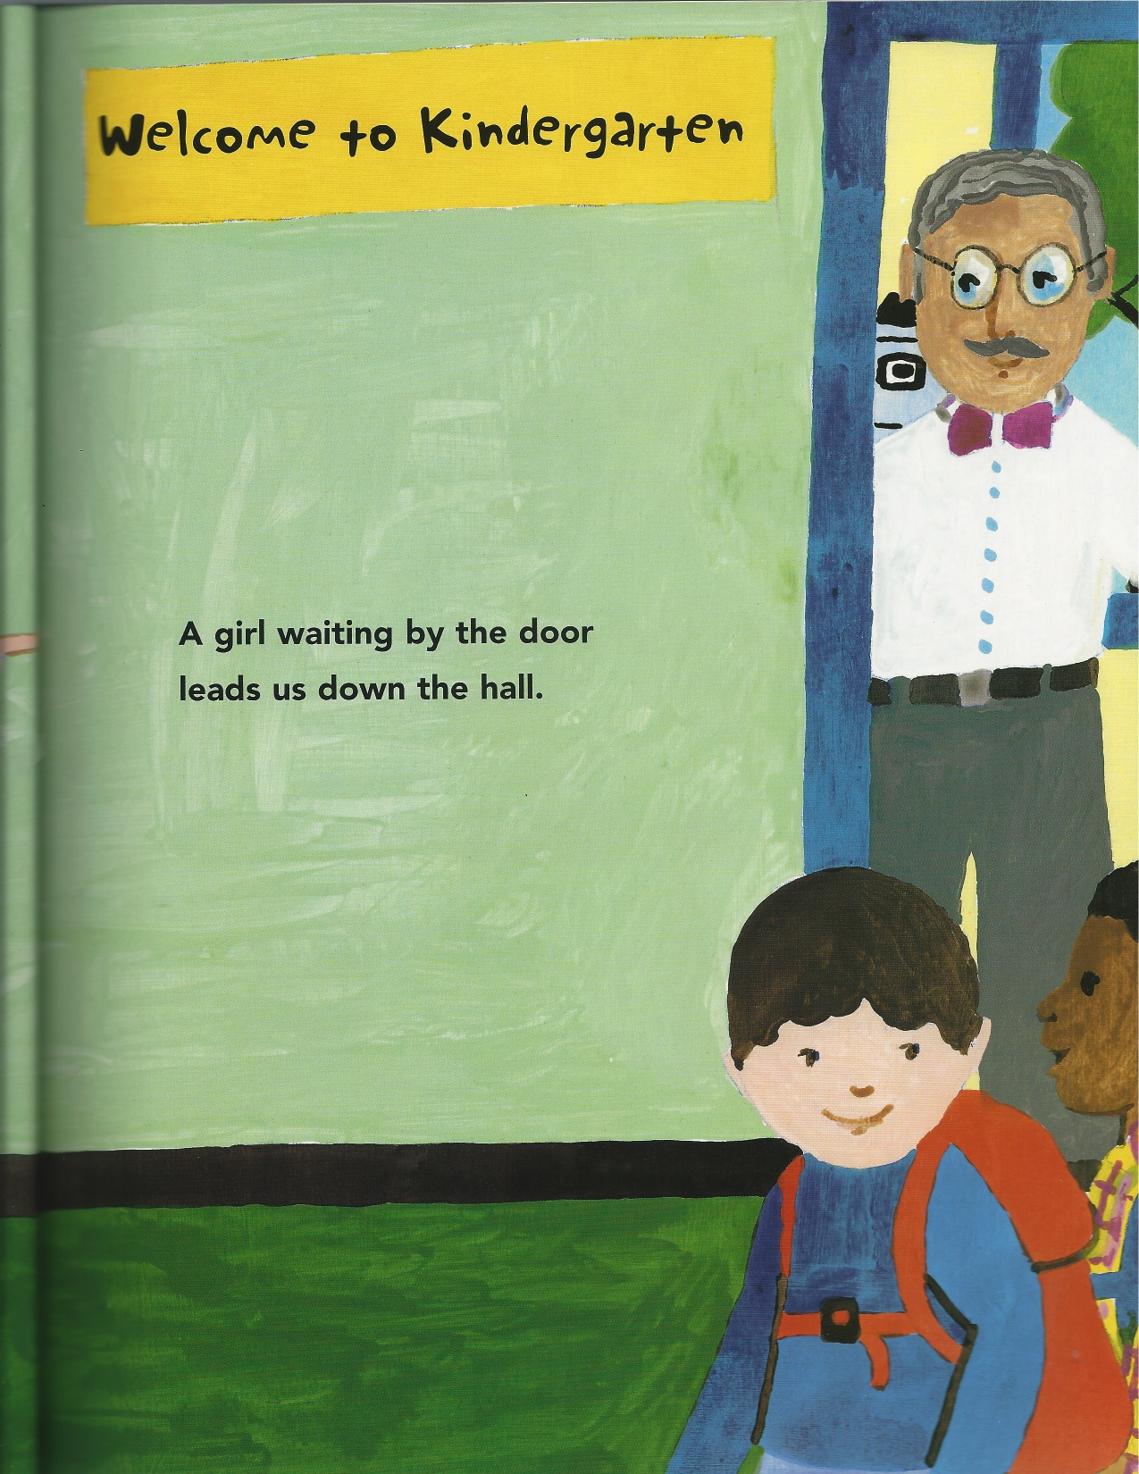

Slide 4
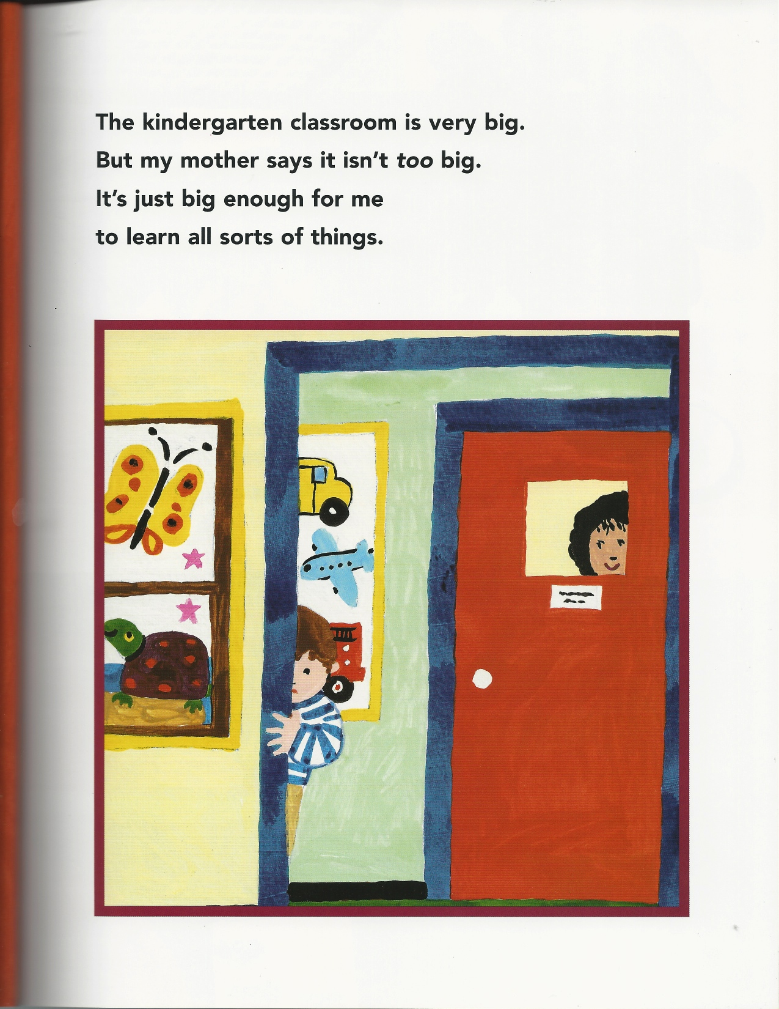

Slide 5
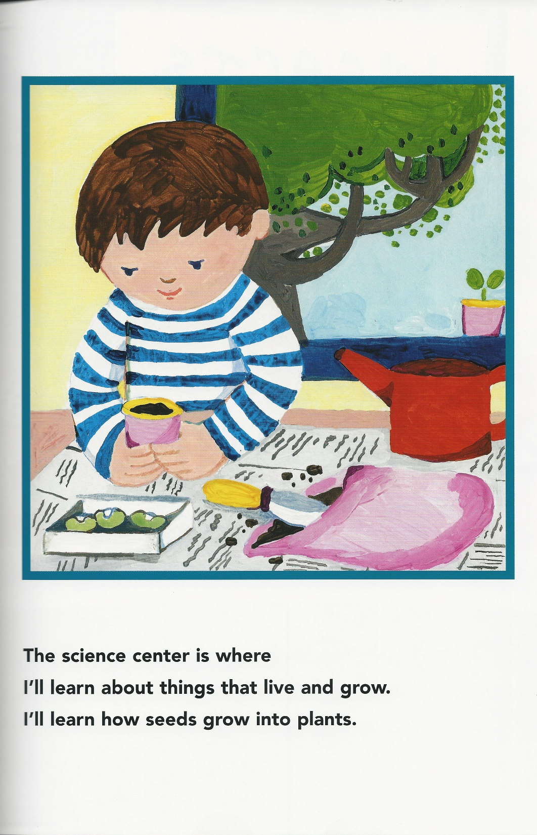

Slide 6
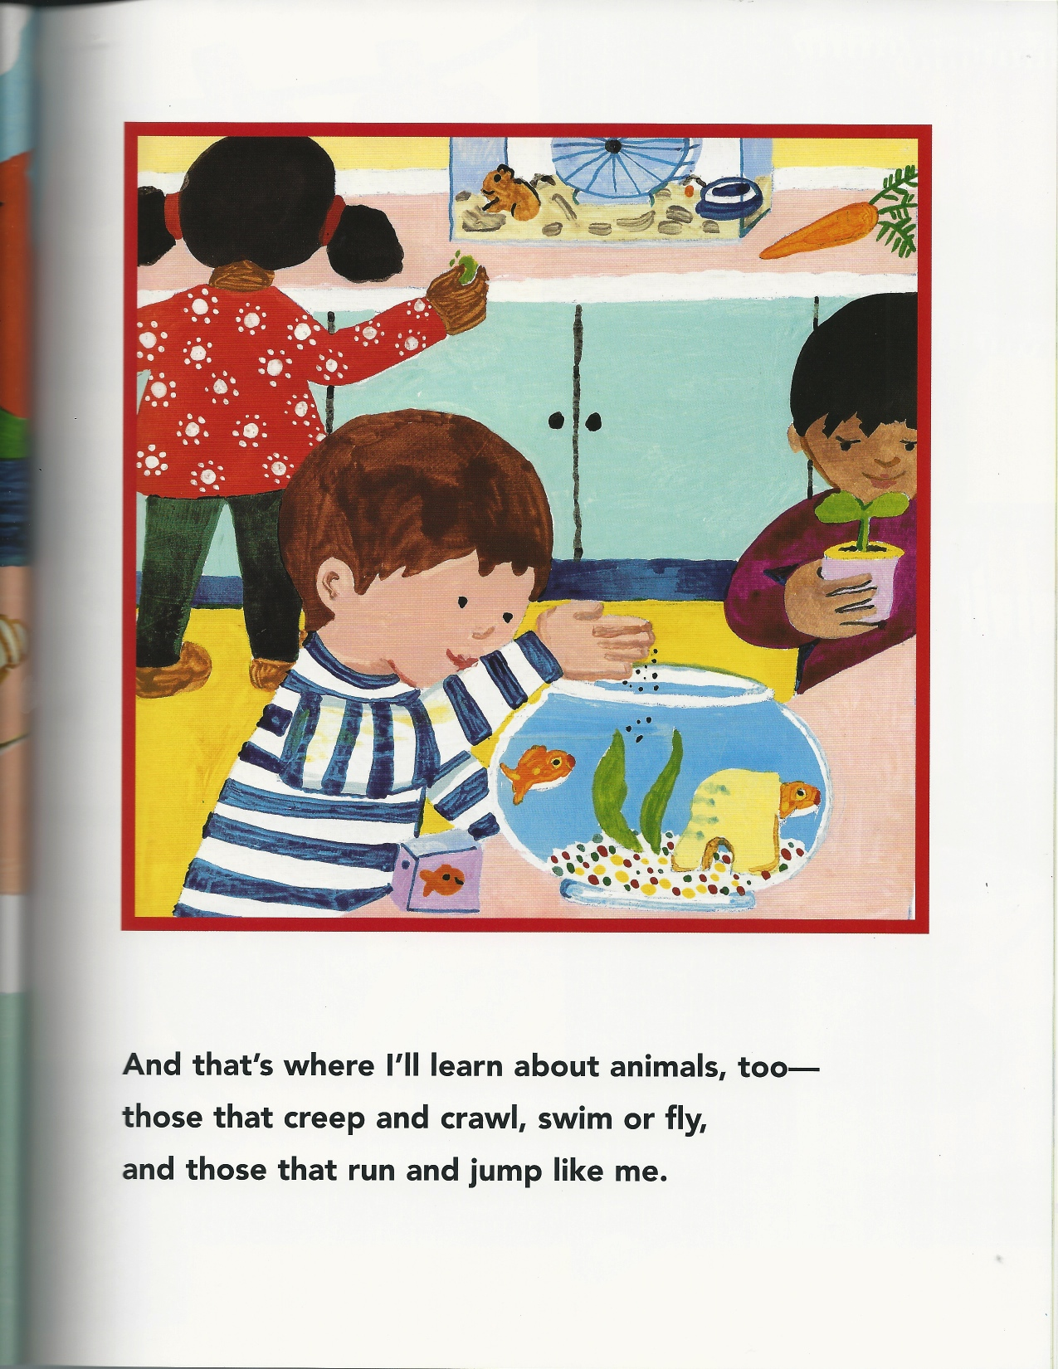

Slide 7
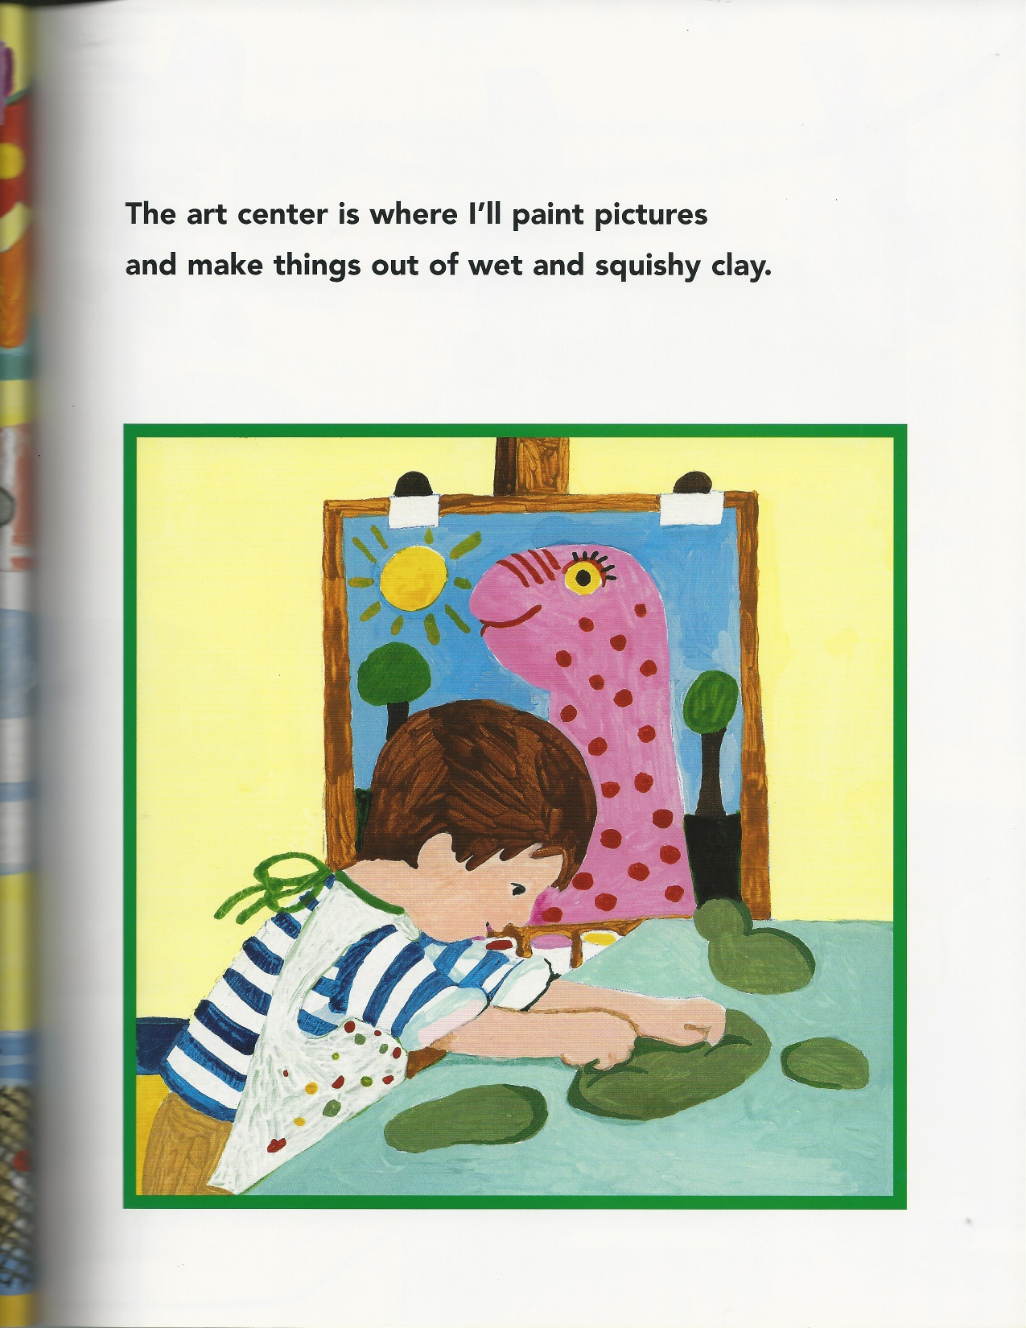

Slide 8
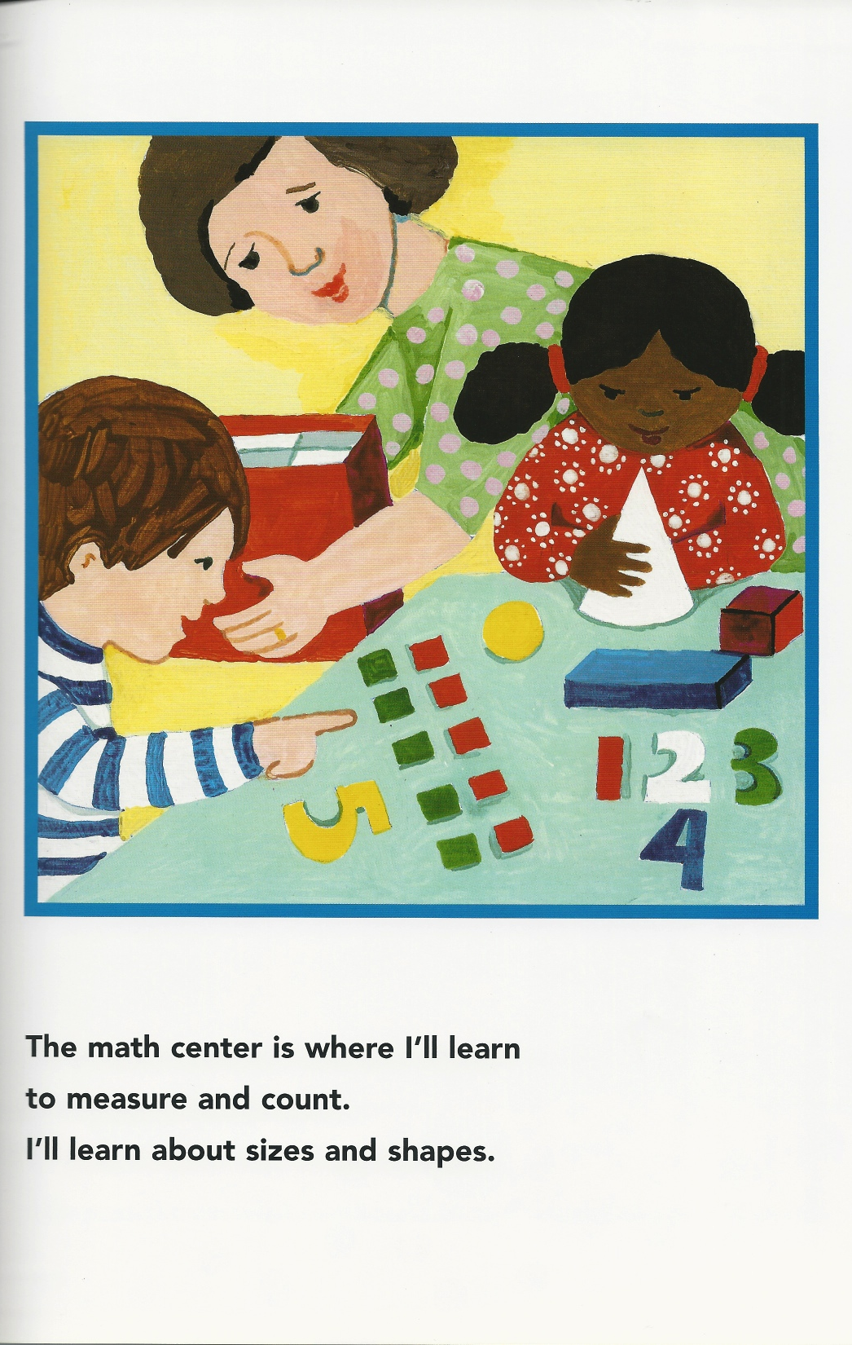

Slide 9
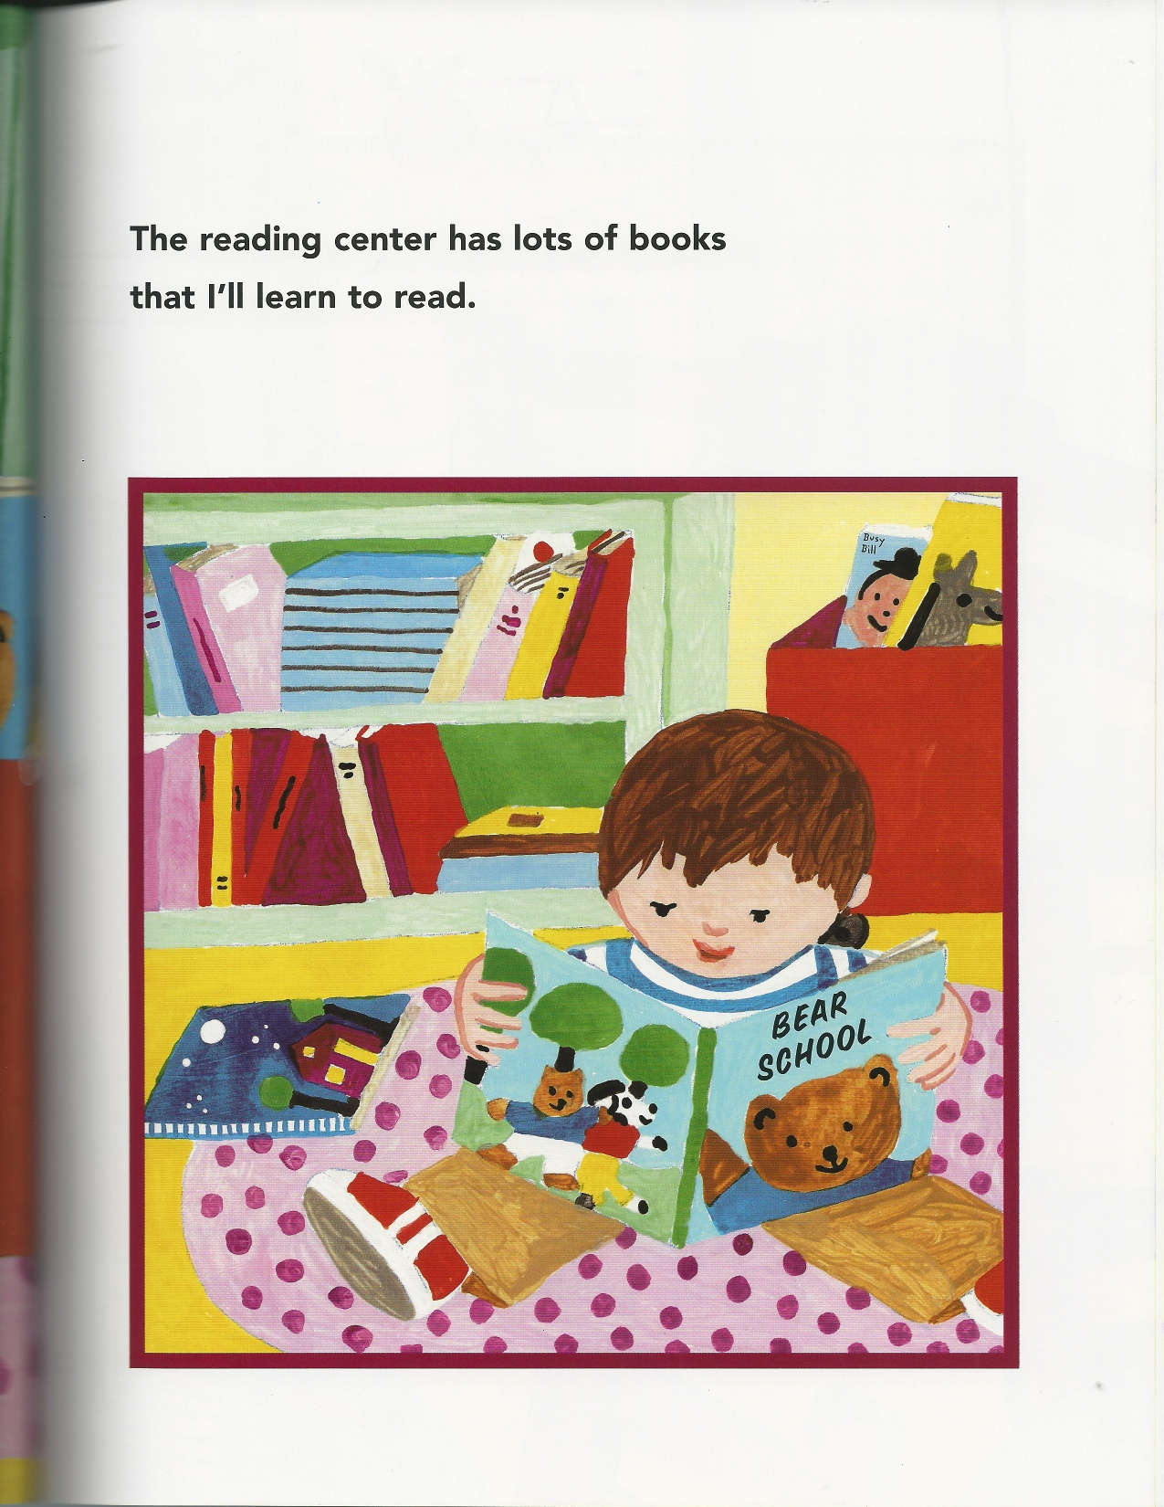

Slide 10
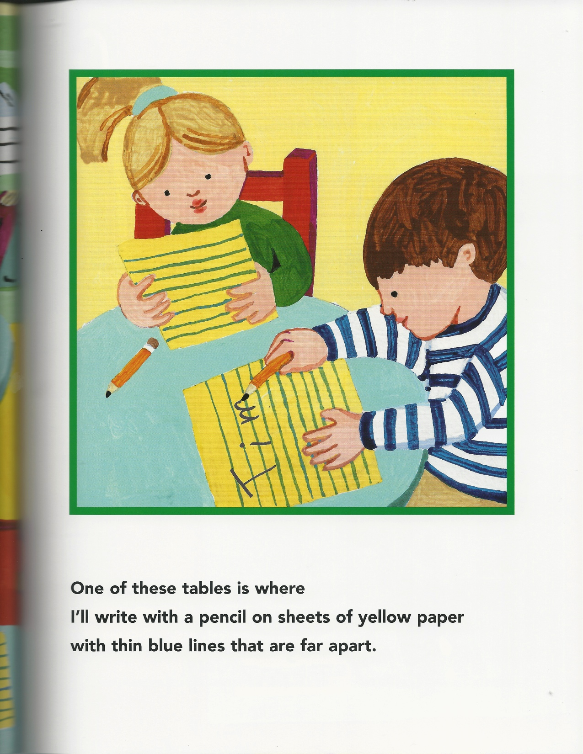

Slide 11
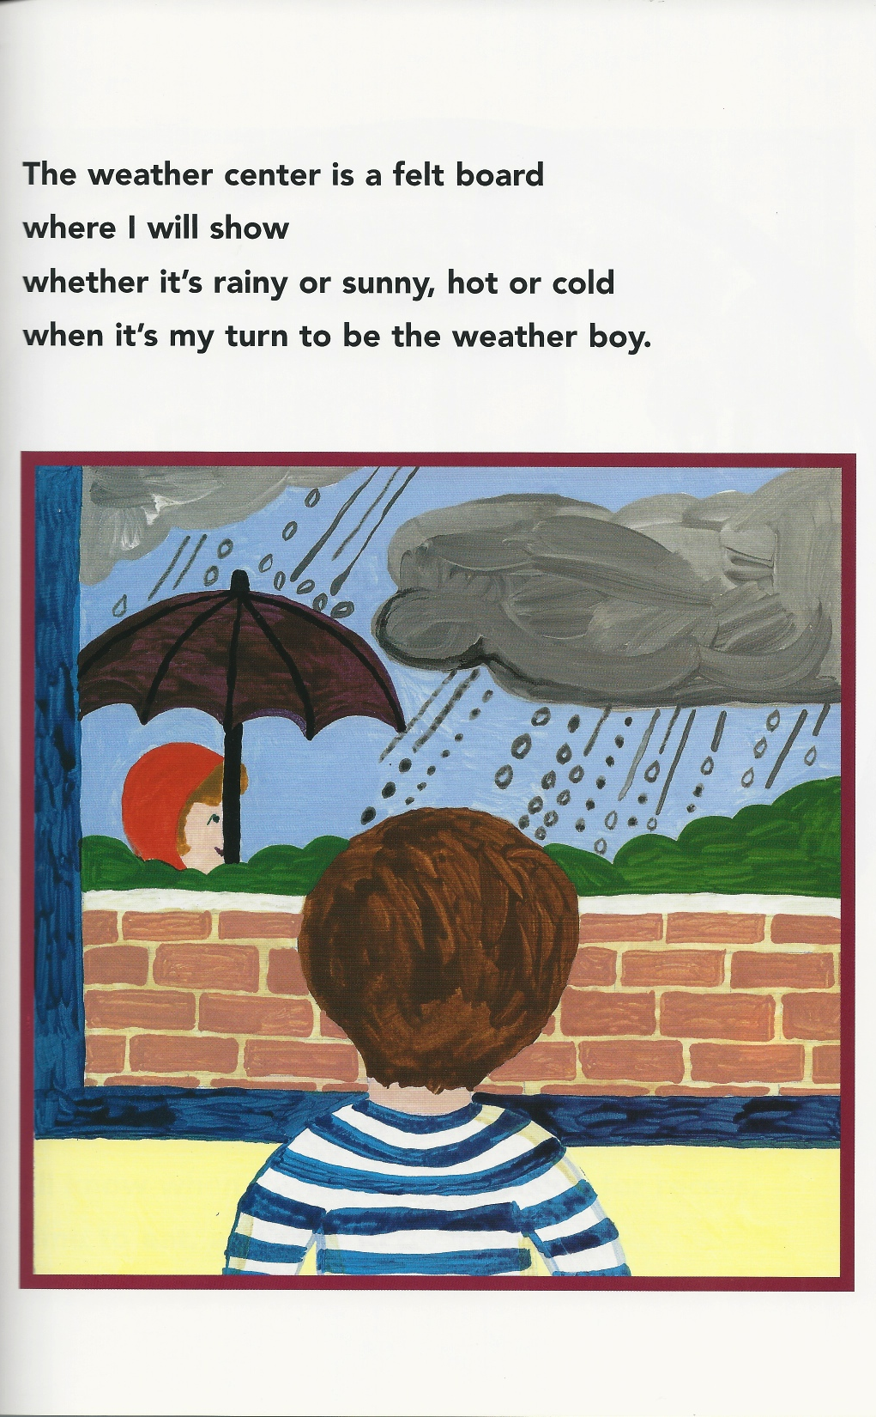

Slide 12
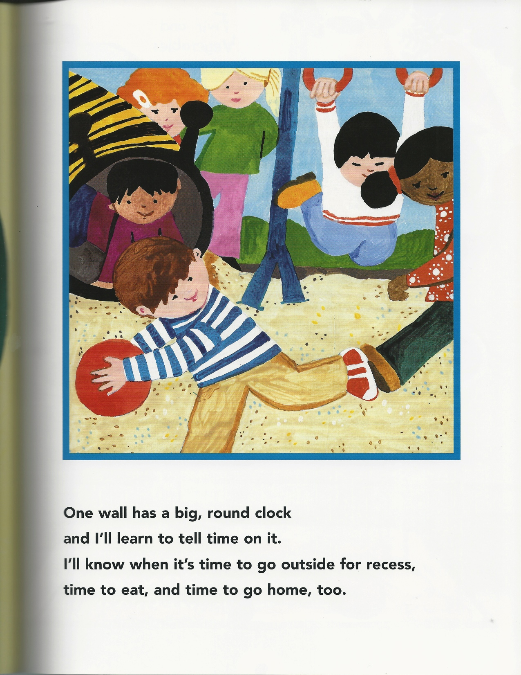

Slide 13
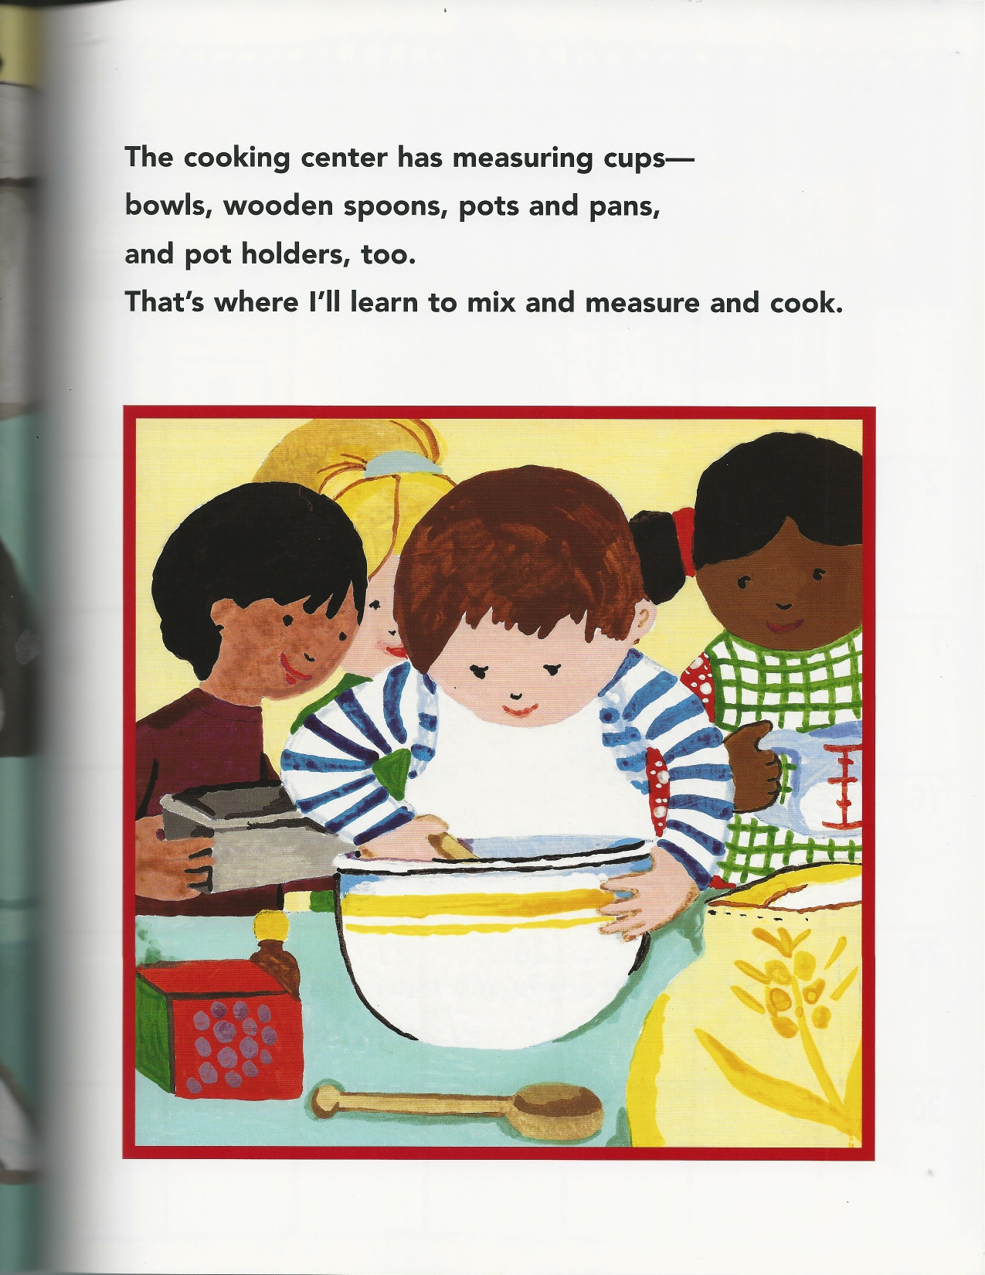

Slide 14
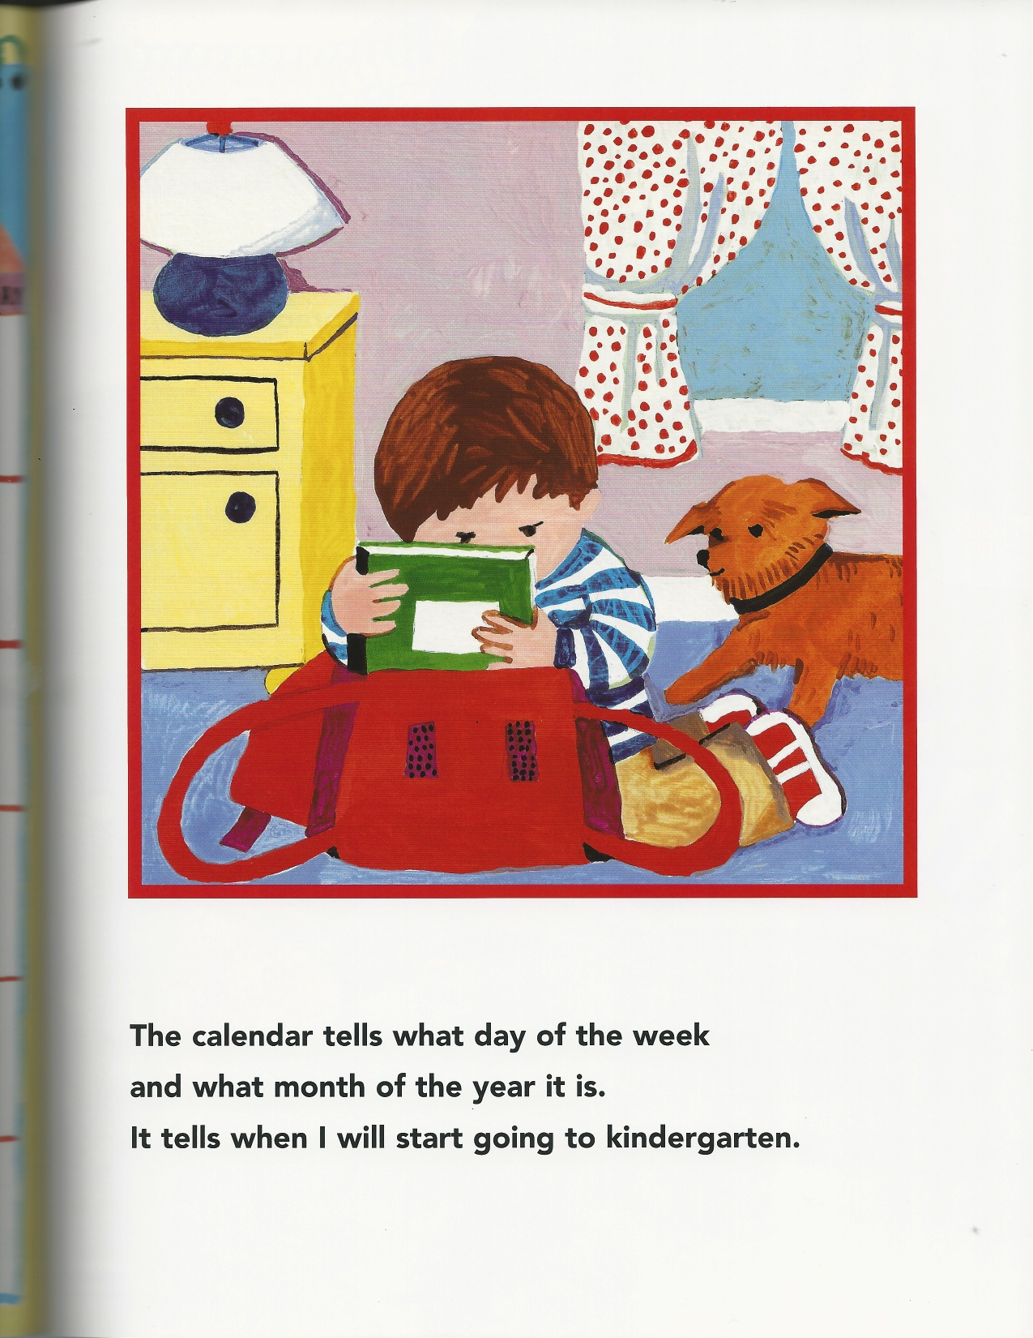

Slide 15
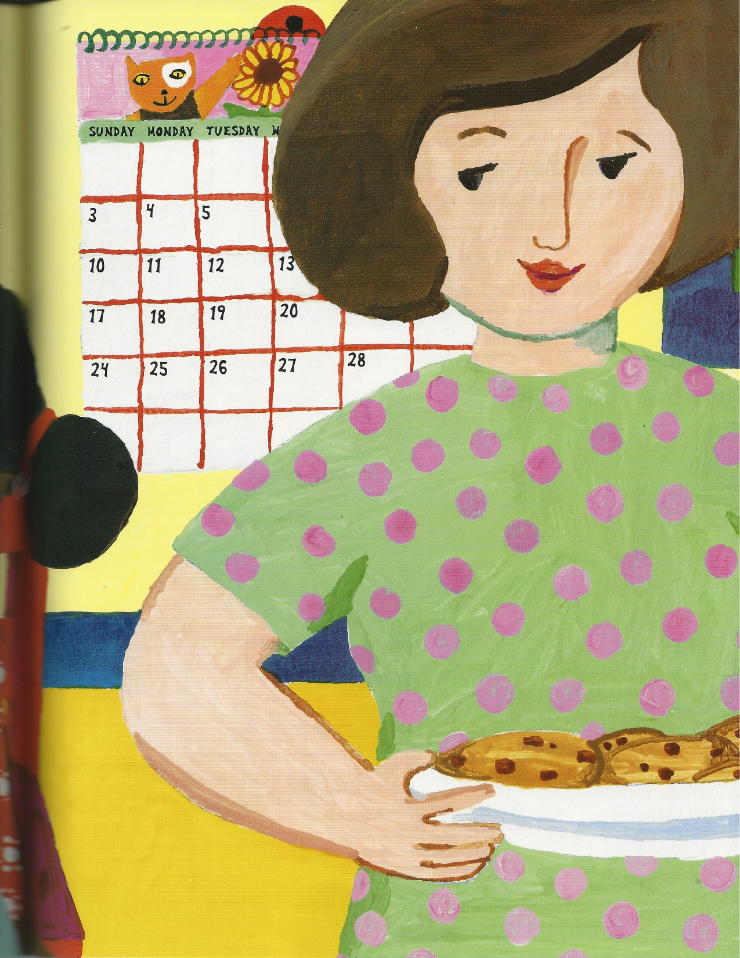

Slide 17
Common Core Standards
K.RL.1
With prompting and support, ask and answer questions about details in a text.
I can ask and answer questions about what I read.

Slide 18
What will Tim learn about in his kindergarten classroom?
Activity 1
While reading the book aloud have students repeat important vocabulary.
Have them look at each picture and tell you what they see.
Activity 2
After reading the book have children tell you what Tim will learn about in kindergarten. Have pictures ready to help them answer the questions.
As the students share their ideas they come up to the board to pick a picture corresponding to what they say.

